Slide 1





Central Luzon Provinces Mission
of the Seventh-day Adventists
PASTORS'
ON-BOARDING
JANUARY 12-14, 2026

Slide 2

SABBATH SCHOOL
& PERSONAL MINISTRY DEPARTMENT DIRECTIVES
CLPM PASTORS' ON-BOARDING BOOTCAMP

Slide 3
The Sabbath School and Personal Ministries Department of the Central Luzon Provinces Mission (CLPM) recognizes that the spiritual preparation of its members and their active participation in evangelism are crucial to the church's strength and growth.
To ensure that every believer is equipped and engaged in fulfilling the gospel commission, the departments intensified their focus on training and evangelism as the twin pillars of its mission in 2026-2030.
The department continues to empower both leaders and lay members to become faithful and effective disciples of Christ through organized training, leadership development, and coordinated evangelistic initiatives.
CLPM PASTORS' ON-BOARDING BOOTCAMP
Notes:
To WIN- to evangelize IN the church and OUTSIDE the church
To HOLD- to nurture, strengthen, and involve
To TRAIN- to make disciples for Jesus Christ

Slide 4
PURPOSE AND OBJECTIVES
The purpose of the department’s training and evangelism programs is:
To nurture
To equip
To mobilize members for dynamic participation in the church's mission.
These initiatives aim to deepen faith, develop leadership, and inspire a spirit of service within the body of Christ.
CLPM PASTORS' ON-BOARDING BOOTCAMP
Notes:
To WIN- to evangelize IN the church and OUTSIDE the church
To HOLD- to nurture, strengthen, and involve
To TRAIN- to make disciples for Jesus Christ

Slide 5
The Sabbath School and Personal Ministries
Department aims:
To equip church members and leaders with Bible teaching skills.
To strengthen the church's spiritual foundation.
To promote total member involvement in evangelism.
To enhance Sabbath School programs, nurture new
believers.
To foster unity.
To encourage daily Bible Study Guides.
To empower lay members to lead small-group
evangelism and public evangelism initiatives.
CLPM PASTORS' ON-BOARDING BOOTCAMP
Notes:
To WIN- to evangelize IN the church and OUTSIDE the church
To HOLD- to nurture, strengthen, and involve
To TRAIN- to make disciples for Jesus Christ

Slide 6
Sabbath School / Personal Ministry Department
2026 CALENDAR OF ACTIVITIES
1. SABBATH SCHOOL LEADERSHIP CERTIFICATION (Level 1) |  | Place | Participant
AREA 1 | MAY 17 | Baler | SS Personnel
AREA 2 | JUNE14 | Cabanatuan | SS Personnel
AREA 3 | JULY 12 | Dinalupihan | SS Personnel
AREA 4 | SEPT 20 | Angeles | SS Personnel
AREA 5 | OCT 11 | Malolos | SS Personnel
2. IICD ENROLLMENT- FEBRUARY – MARCH |  | By District | Pastor
3. IICD ORIENTATION (Online) - April 5 |  | Virtual | Member / Leader
4. OPENING OF IICD TRAINING - April 12 |  | By District | Member / Leader
5. IICD GRADUATION – September 26 |  | Pampanga | Candidates
6. WEEK OF REVIVAL & REFORMATION – January 26-31 |  | By Church | By Church
CLPM PASTORS' ON-BOARDING BOOTCAMP

Slide 7
DATA NEEDED GATHERING
# OF FUNCTIONAL CARE GROUP # OF ELDERS SS CERTIFIED # OF SS PERSONNEL CERTIFIED # OF SS SECRETARY CERTIFIED # OF CARE GROUP LEADER CERTIFIED
CLPM PASTORS' ON-BOARDING BOOTCAMP

Slide 8
RESOURCES RELATED AVAILABLE
1. Sabbath School handbook
2. Sabbath School superintendent Certification
3. Sabbath School Teacher’s Certification
4. Care Group Module
5. Discipleship Handbook
6. Church Manual
CLPM PASTORS' ON-BOARDING BOOTCAMP

Slide 9
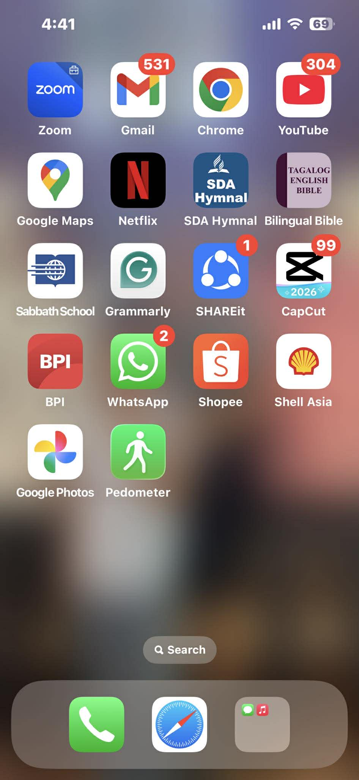
WEBSITE RECOMMENDATION
Sabbath School: Quarterly Lesson
Sabbath School
https://www.sabbath.school
Sabbath School
Adventech
https://sabbath-school.adventech.io
Sabbath School Net: Home
Sabbath School Net
https://ssnet.org
https://sspmadventist.org/
https://www.youtube.com/playlist?list=PLKejbZSBAyL-63Jm30Y5BYwA7JDs0Eyjq
https://www.youtube.com/watch?v=5_Af1r7qnRE
Sabbath School Apps
CLPM PASTORS' ON-BOARDING BOOTCAMP

Slide 10
NDR-IEL
DIRECTIVES
CLPM PASTORS' ON-BOARDING BOOTCAMP

Slide 11
The Nurture, Discipleship, and Reclamation (NDR-IEL) program of the Central Luzon Provinces Mission continues to be one of the most vital strategies for church stability and spiritual growth.
This initiative aims to strengthen the faith of new and long-time believers, reclaim missing members, and equip disciples to actively participate in God’s mission.
CLPM PASTORS' ON-BOARDING BOOTCAMP

Slide 12
Purpose and Objectives
The purpose is:
To guide new believers through Bible study, prayer, and fellowship.
To equip church members for discipleship.
To reclaim former members.
To strengthen unity.
To sustain growth and retention.
2,549
CLPM PASTORS' ON-BOARDING BOOTCAMP

Slide 13
Purpose and Objectives
The objective is to establish nurturing programs, conduct discipleship training, implement a reclamation plan, encourage believers to become mentors, and develop evaluation tools to monitor growth, retention, and member engagement.
CLPM PASTORS' ON-BOARDING BOOTCAMP

Slide 14
NURTURING AND RETENTION PROGRAMS
FOR NEW MEMBERS
CLPM PASTORS' ON-BOARDING BOOTCAMP

Slide 15
Objectives of Nurturing and Retention Programs for New Converts
To address the spiritual needs of new believers by providing
them a comprehensive program for nurturing so that they
would have a strong grasp of the basis of their faith.
2. To give new believers guidance for the strengthening of their abiding
relationship with Christ and with their local church through the
practice of personal communion with God and fellowship with
church members.
3. To provide watchful attention, help and encouragement for the new
converts as they move forward to becoming a mature Seventh-day
Adventist members through visitation, involvement in worship, social
activities and witnessing.
CLPM PASTORS' ON-BOARDING BOOTCAMP

Slide 16
Objectives of Nurturing and Retention Program for New Converts
4. To develop in new members a sense of belonging among the newly
baptized members of the church.
5. To provide new coverts with meaningful experiences to exercise their
faith in God.
6. To assess the readiness of new converts to be part of the community
of believers as a whole.
7. To evaluate the strengths and weaknesses of the implementation of
retention and nurturing program.
CLPM PASTORS' ON-BOARDING BOOTCAMP

Slide 17
ORGANIZE NDR-IEL COMMITTEE
CLPM PASTORS' ON-BOARDING BOOTCAMP

Slide 18
Organize NDR-IEL Committee
A Nurture Discipleship and Reclamation Committee (NDR)-IEL shall be organized by the action of the local church board upon the recommendation of the church/district pastor.
Chairman: NDR-IEL Leader
Secretary: Personal Ministries
Members:
Church Clerk Sabbath School
Personal Ministries (PM) Women Family
Head Deacon Head Deaconness Youth Pastor/Elders
CLPM PASTORS' ON-BOARDING BOOTCAMP

Slide 19
Duties of NDR-IEL Committee
1. Prepare the NRP of the local church and have overall
supervision over it.
2. Conduct regular monitoring of the program and make
regular reports to the church.
3. Recommend to the church board the establishment of a
Nurturing Class under the Sabbath School Department.
4. Ensure that all newly baptized members are enrolled and
regularly attending the Nurturing Class.
CLPM PASTORS' ON-BOARDING BOOTCAMP

Slide 20
Duties of NDR-IEL Committee
5. Prepare annual action plan and budget for the NRP a part of
the spiritual program of the church.
6. Ensure that all candidates for baptism have been assigned
their respective personal spiritual guardian.
7. Update the NRP of the church, as may be necessary.
CLPM PASTORS' ON-BOARDING BOOTCAMP

Slide 21
NDR-IEL
2026 CALENDAR OF ACTIVITIES
1. DISCIPLES EDUCATORS PROGRAM
PLACE | Date | # Participant
AREA 1 | Feb 8 | 15 Leaders
AREA 2 | Feb 1 | 15 Leaders
AREA 3 | Feb 15 | 15 Leaders
AREA 4 | March 29 | 15 Leaders
AREA 5 | March 15 | 15 Leaders
2. NEW MEMBERS TRAINORS TRAINING
AREA 1 | June 13 | 10 Participants
AREA 2 | March 21 | 10 Particpants
AREA | April 25 | 10 Particpants
AREA 4 | May 23 | 10 Particpants
AREA 5 | June 27 | 10 Particpants
3. MISSION REACH 26 ORIENTATION | January 11 | 300 Participants
CLPM PASTORS' ON-BOARDING BOOTCAMP

Slide 22
DATA NEEDED GATHERING
# OF BAPTISM BY MONTHLY / QUARTERLY / YEARLY # OF RETENTION AFTER 6 MONTHS / 1 YEAR # OF RECLAIMED MEMBERS ORGANIZE NDR-IEL COMMITTEE BY CHURCH Attachment: Approved NDR-IEL Committee
CLPM PASTORS' ON-BOARDING BOOTCAMP

Slide 23
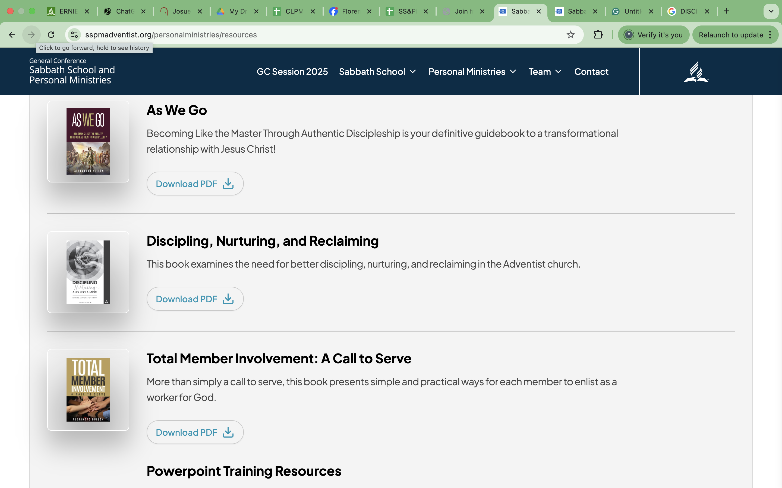
WEBSITE RECOMMENDATION
1. https://worldmissionsevangelism.com/wp-content/uploads/2020/10/Family-Disciple-Making-Mirrored-Margins.pdf
2. https://sspmadventist.org/personalministries/resources
CLPM PASTORS' ON-BOARDING BOOTCAMP

Slide 24
ACS
DIRECTIVES
CLPM PASTORS' ON-BOARDING BOOTCAMP

Slide 25
Adventist Community Services (ACS) serves as the compassionate arm of the Seventh-day Adventist Church, designed to respond to the needs of people—physically, emotionally, and spiritually. Through acts of kindness, service, and community engagement, ACS becomes the bridge that connects the church to the community, sharing the love and character of Jesus in practical and life-changing ways.
CLPM PASTORS' ON-BOARDING BOOTCAMP

Slide 26
PURPOSE AND OBJECTIVES
The main purpose of Adventist Community Services is to reveal Christ’s love through service and to bring hope and healing to individuals and communities. It aims to show that Christianity is not only a faith professed but a life lived in service to others.
The objective is to bridge the gap between church and community, demonstrating Christ's compassion through practical ministry, fostering volunteerism, responding to emergencies, promoting holistic well-being through education and livelihood assistance, and preparing hearts for evangelism.
CLPM PASTORS' ON-BOARDING BOOTCAMP
Notes:
To WIN- to evangelize IN the church and OUTSIDE the church
To HOLD- to nurture, strengthen, and involve
To TRAIN- to make disciples for Jesus Christ

Slide 27
NDR-IEL
2026 CALENDAR OF ACTIVITIES
1. ACS LEADERS TRAINING ONLINE
PLACE | Date | Participant
AREA 1 | April 12 | ACS Leaders / Pastors
AREA 2 | April 19 | ACS Leaders ‘/ Pastors
AREA 3 | May 10 | ACS Leaders / Pastors
AREA 4 | May 31 | ACS Leaders / Pastors
AREA 5 | June 21 | ACS Leaders / Pastors
2. ORGANIZE ACS CHAPTER BY AREA
3. DISTRIBUTE MEDICAL EQUIPMENT
4. CLPM GIFT GIVING
CLPM PASTORS' ON-BOARDING BOOTCAMP

Slide 28
DATA NEEDED GATHERING
# of Churches Conducted Gift Giving # of Churches Conducted Adopt A Barangay
CLPM PASTORS' ON-BOARDING BOOTCAMP

Slide 29
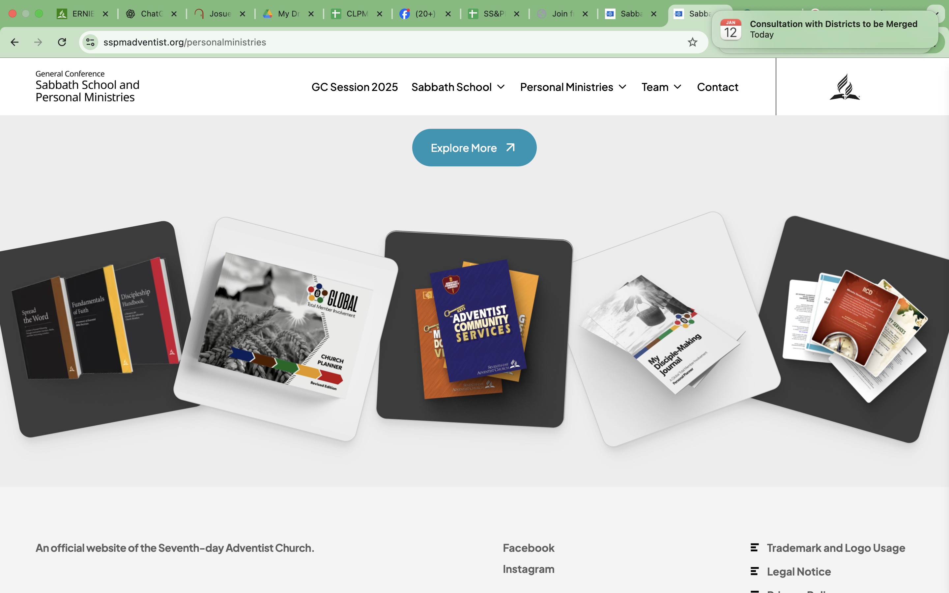
WEBSITE RECOMMENDATION
1. https://sspmadventist.org/personalministries/resources
CLPM PASTORS' ON-BOARDING BOOTCAMP

Slide 30
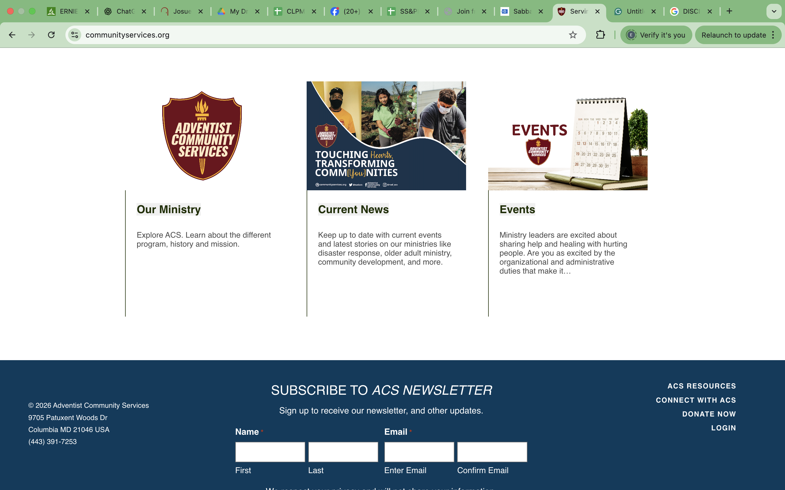
2. https://www.communityservices.org/
WEBSITE RECOMMENDATION
CLPM PASTORS' ON-BOARDING BOOTCAMP

