Slide 1




Central Luzon Provinces Mission
of the Seventh-day Adventists
PASTORS’
ON-BOARDING
SESSION
JANUARY 12, 2026
Notes:
Title: “How Long Have You Served?”
Instructions:
Ask pastors to raise hands as you call out years:
“Please raise your hand if you have served 5 years or more”
“10 years or more”
“15 years or more”
“20… 25… 30 years or more”
(Pause and acknowledge)
“Pastors, may I ask you to think back for a moment—
Do you remember your first district, your first salary, or your first church member who called you ‘Pastor’?”
You say:
“Thank you, pastors.
What you see in this room is not just experience—
it is decades of sacrifice, faithfulness, and trust in God.”
Key bridge line:
“The retirement plan we will discuss today begins at 15 years, but it is really about honoring every year represented in this room.”

Slide 2

PROPOSED REMUNERATION 2026
Approved Recommended Year 2025 Year 2026
Wage Factor 37,000.00 39,000.00
Cost of Living Allowance 6,500.00 6,500. 00
CLPM OFFICE WORKERS' ON-BOARDING

Slide 3
PROPOSED REMUNERATION 2026
Approved Recommended Year 2025 Year 2026
Road Tax (Car Registration) 100% 100%
Car Insurance 9,000.00 9,000.00
For Officers, Directors, and designated employees, upon approval of each of the controlling committees.
CLPM OFFICE WORKERS' ON-BOARDING

Slide 4
PROPOSED REMUNERATION 2026
Approved Recommended Year 2025 Year 2026
Health Care Assistance
Medical As per policy As per policy
Optical
Workers 4,500.00 4,500.00
Officers/Directors 6,500.00 6,500.00
Dependent Up to 3,500.00 Up to 3,500.00
Dental
Workers 12,000.00 12,000.00
Officers/Directors 14,500.00 14,500.00
Dependent Up to 9,000.00 9,000.00
CLPM OFFICE WORKERS' ON-BOARDING

Slide 5
PROPOSED REMUNERATION 2026
Approved Recommended Year 2025 Year 2026
House Rental 15% basic salary 15% basic salary
Final Moving Allowance As per policy As per policy
CLPM OFFICE WORKERS' ON-BOARDING

Slide 6
Retiring Employees – An employee who has at some time during their denominational employment been moved at denominational expense, may be granted assistance in the form of reimbursement for actual moving expenses, or at the employer’s option, a cash
settlement on moving expenses, when an actual move is made to the place of retirement according to the following provisions:
a. Over Thirty Years Service – When an employee who has given thirty years or more of
denominational service retires, the employing organization may arrange to pay the moving expense on a reasonable amount of household goods and pay transportation expense by the most direct route to a location of the employee’s choice in their base union country.
CLPM OFFICE WORKERS' ON-BOARDING

Slide 7
b. Under Thirty Years Service – An employee who has served less than thirty years may be paid a proportionately less amount. The amount of the moving expense reimbursement shall be decided by the employing organization.
c. Arrangement – This arrangement is limited to one move only and must be made within a period of five years after retirement unless some other definite arrangement is approved by the governing committee.
d. Responsibility for Expense – in cases where both spouses are denominationally employed at the time of retirement but by different organizations, the moving assistance to the place of retirement shall be shared equally by the two employers if both spouses are vested
for retirement benefits. If one spouse is not vested, the moving assistance shall be paid by the employer of the spouse who is vested.
CLPM OFFICE WORKERS' ON-BOARDING

Slide 8
PROPOSED TRAVEL ASSISTANCE 2026
 | Area Coordinator | Field Pastors | Tarlac
Area 1 | 9,000.00 | 7,500.00
Area 2 | 8,000.00 | 7,000.00
Area 3 | 8,000.00 | 7,000.00
Area 4 | 7,500.00 | 6,000.00 | 7,000.00
Area 5 | 7,500.00 | 6,500.00
CLPM OFFICE WORKERS' ON-BOARDING

Slide 9
Y 20 Life Insurance
Y 20 06 Global Life (GBL) insurance – A life insurance policy with coverage for nearly any cause of death. Each denominational organization is required to secure this insurance through SSD Risk Management Services, for all regular fulltime denominational employees.
Y 20 11 Accident Insurance – Accidental Death and Dismemberment (AD&D) insurance – a policy with coverage for accidental death or loss of body parts shall be recommended, in addition to Global Life insurance, for all denominational entities within the Division
territory for their regular employees based on exposure to the risks of the given work assignment.
CLPM OFFICE WORKERS' ON-BOARDING
Notes:
1. Coverage limits range from $5,000 - $100,000 in
increments of $5,000.
2. Spouse coverage is 50% of employee amount
for spouses who do not work full time for the
organization.
3. If the entity in which the denominational
employee serves has not provided life insurance and a
claim occurs, the entity will be responsible for paying
the amount equivalent to what the insurance would pay
in each case. (Min of $5,000 per #1)
4. The employing organization’s treasury
department is responsible for ensuring that updates
and renewals are in place as per required schedule.
Coverage limit for accidental death and dismemberment
ranges from $5,000 - $250,000 for employee and spouse,
and 50% of employee coverage limits to a maximum of
$15,000 for dependent child(ren). The employing
organization’s treasury department is responsible for
ensuring updates and renewals are in place as per
required schedule.

Slide 10
Purpose of the Retirement Plan
Provide financial security to denominational employees after service
Covers retirement, disability, and survivor assistance
Designed for equity, sustainability, and worker care
CLPM OFFICE WORKERS' ON-BOARDING

Slide 11
Eligibility Requirements
Minimum of 15 full years of denominational service
Normal retirement age: 65
Optional early retirement: Age 60 with 30 years (60/30)
CLPM OFFICE WORKERS' ON-BOARDING

Slide 12
Sample Computation
Age – 63
Years of Service – 35
Age difference – 2 years
Service difference – 5 years
SSD Wage factor x 2 x short of retirement age = Penalty
Php 42,000 x 2 =84,000 x 2 years = 168,000
CLPM OFFICE WORKERS' ON-BOARDING

Slide 13
Service Credit Rules
Earned through regular full-time denominational employment
Verified by employing organization
Maximum of 40 years credited
CLPM OFFICE WORKERS' ON-BOARDING

Slide 14
Monthly Retirement Benefits
15 years: 30% of approved wage scale (family rate)
16–20 years: +1% per year
21–30 years: +1.5% per year
31–40 years: +2% per year
CLPM OFFICE WORKERS' ON-BOARDING

Slide 15
Benefit Computation
Based on 10 highest audited remuneration rates
Uses SSD-approved country wage factor
CLPM OFFICE WORKERS' ON-BOARDING

Slide 16
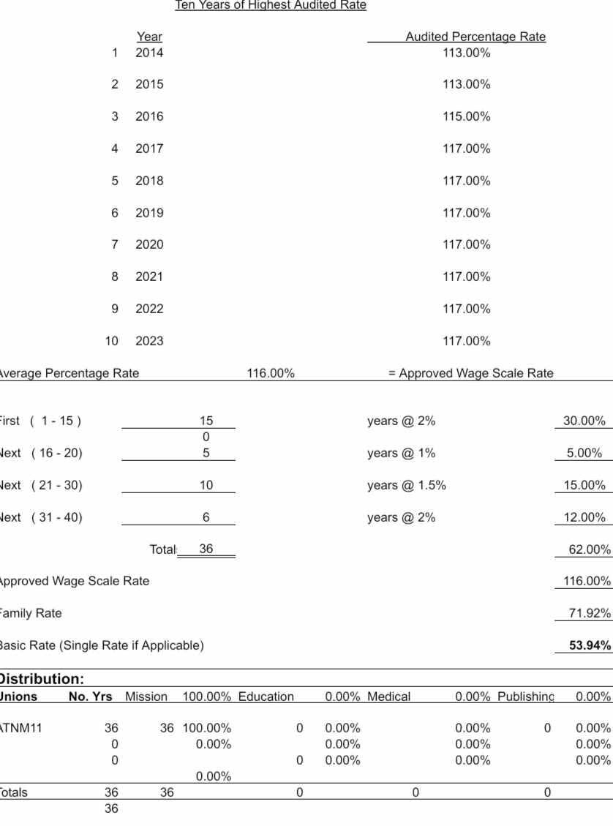
Sample Computation
CLPM OFFICE WORKERS' ON-BOARDING

Slide 17
Health-Care Assistance
No medical assistance below 15 years
At 15 years: 25% outpatient, 40% inpatient
Increases with additional years
CLPM OFFICE WORKERS' ON-BOARDING

Slide 18
Administration & Oversight
Administered by unions / attached missions
Approved by SSD Retirement Plan Committee
Subject to audit and policy compliance
CLPM OFFICE WORKERS' ON-BOARDING

Slide 19
Key Takeaways
15 years is the gateway to retirement benefits
Benefits grow with length of service
Plan reflects care, fairness, and stewardship
CLPM OFFICE WORKERS' ON-BOARDING

Slide 20
WRA POLICY
Workers' reportable accounts are to be reported within two weeks. Delay of such a report will be deducted from the employee's payroll.
No WRA is to be issued while the first WRA is not yet settled.
CLPM OFFICE WORKERS' ON-BOARDING

Slide 21
Other Concerns
Cut-off date for monthly remittances – every first Wednesday of the month.
CLPM OFFICE WORKERS' ON-BOARDING

