Slide 1






Central Luzon Provinces Mission
of the Seventh-day Adventists
Departmental Directives
ADVENTIST FAMILY MINISTRIES
CLPM CHURCH OFFICERS’ ORIENTATION
JANUARY 18, 2026

Slide 2


Mission Statement:
Adventist Family Ministries seeks to strengthen, inspire hope, and bring healing to marriages, families, and individuals through the abundant love and saving grace of Jesus Christ.
CLPM CHURCH OFFICERS’ ORIENTATION

Slide 3
OBJECTIVES
To revive the concept of worldwide mission and sacrifice for mission as a way of life involving not only pastors, but every church member, young and old, in
the joy of witnessing for Christ.
To disciple individuals and families into spirit-filled lives.
To increase accession, retention, reclamation, and participation of children, youth, and young adults.
To strengthen the role of the AFM Leaders in the local church with regular growth opportunities.
CLPM CHURCH OFFICERS’ ORIENTATION
Notes:
FAMILY TIME before sabbath school

Slide 4
DUTIES AND RESPONSIBILITIES
The family ministries leader designs a ministry to families that will meet the specific needs of the congregation and community.
Be a family advocate. Family ministries is not merely program-oriented, but must look at the whole church program with sensitivity to its impact on families. In some situations the family ministries leader may need to advocate for FAMILY TIME.
Survey family needs and interests in the congregation. The needs assessment survey and family profile sheet may be used to help determine the needs of the congregation.
Plan programs and activities for the year that may include, retreats or workshops and seminars.
CLPM CHURCH OFFICERS’ ORIENTATION
Notes:
FAMILY TIME before sabbath school
Work with the pastor and church board to be sure plans are included in
the local church budget.
6. Make use of the resources available from the conference family ministries
department. These can save time, energy and serve to keep costs down
for the local congregation. When planning for special presentations, the
conference family ministries director is able to assist in finding interesting
and qualified presenters.
7. Communicate with the congregation. Family ministries should not be
perceived simply as an annual event. Keep the importance of good
family skills alive by use of posters, the church newsletter and/or bulletin
throughout the year.
8. Share your plans with the conference family ministries director.

Slide 5
ADVENTIST FAMILY MINISTRIES CALENDAR 2026
January 18 – CLPM Church Officers Orientation (via zoom)
February 14-21 - Christian Home and Marriage Week (local church)
May 15-17 - Family Life and Couple’s Retreat (TBA)
August 7-8 – AFM Leadership Certification Level 1
September 6-12 Family Togetherness Week of Prayer (local church)
CLPM CHURCH OFFICERS’ ORIENTATION

Slide 6
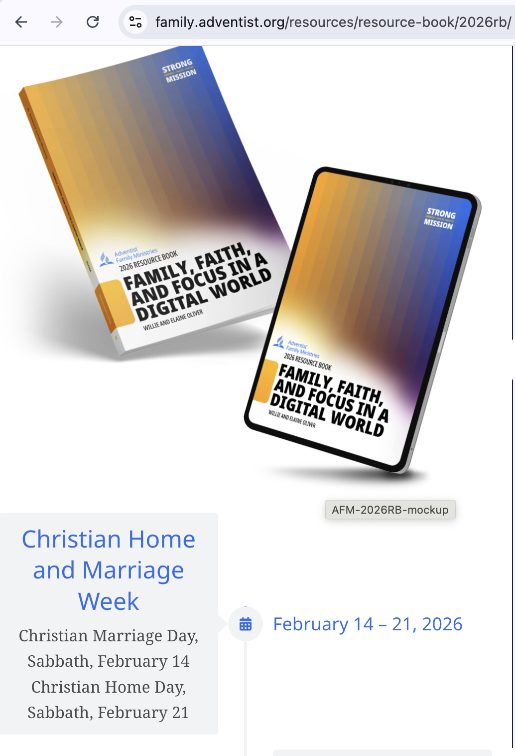
CLPM CHURCH OFFICERS’ ORIENTATION
Notes:
CHRISTIAN marriage day – emphasis in marriage – marriage sermon and marriage seminar
Christian Home Day – emphasiS in parenting

Slide 7
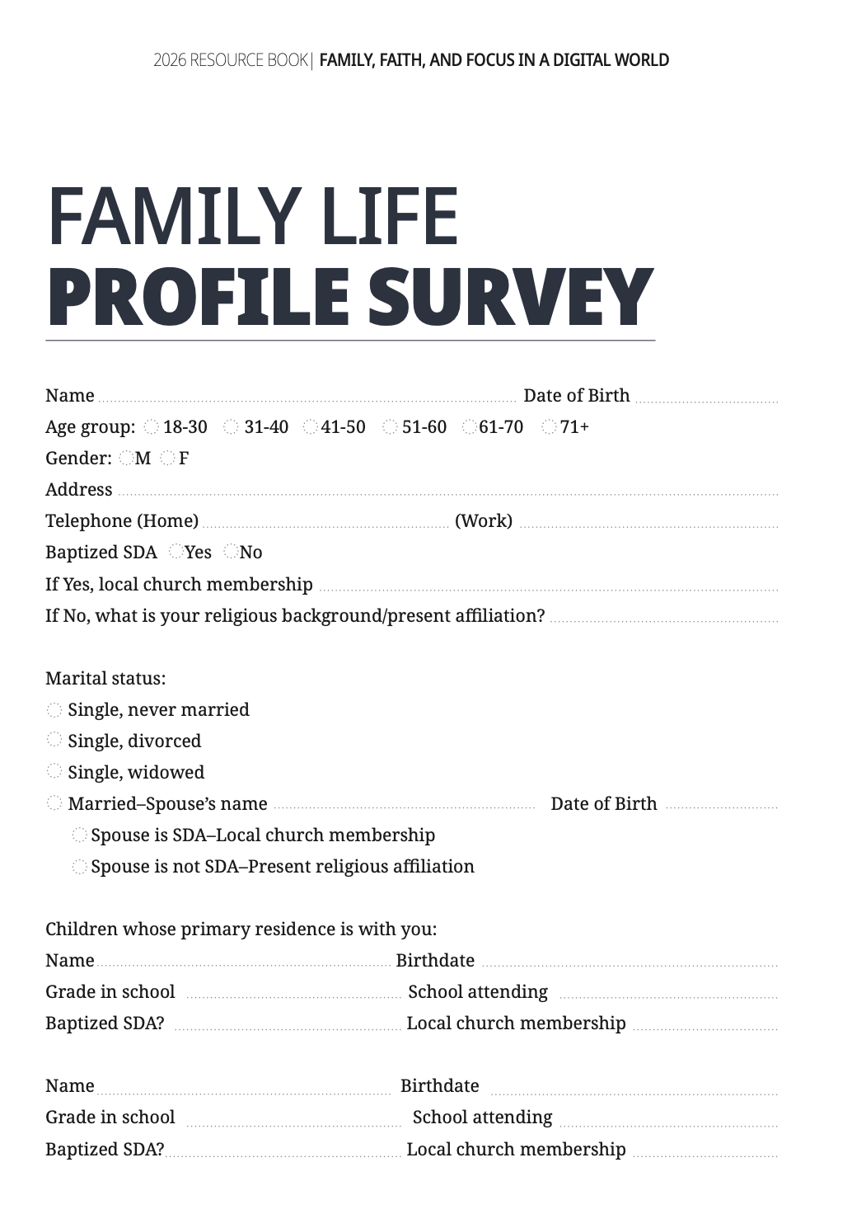
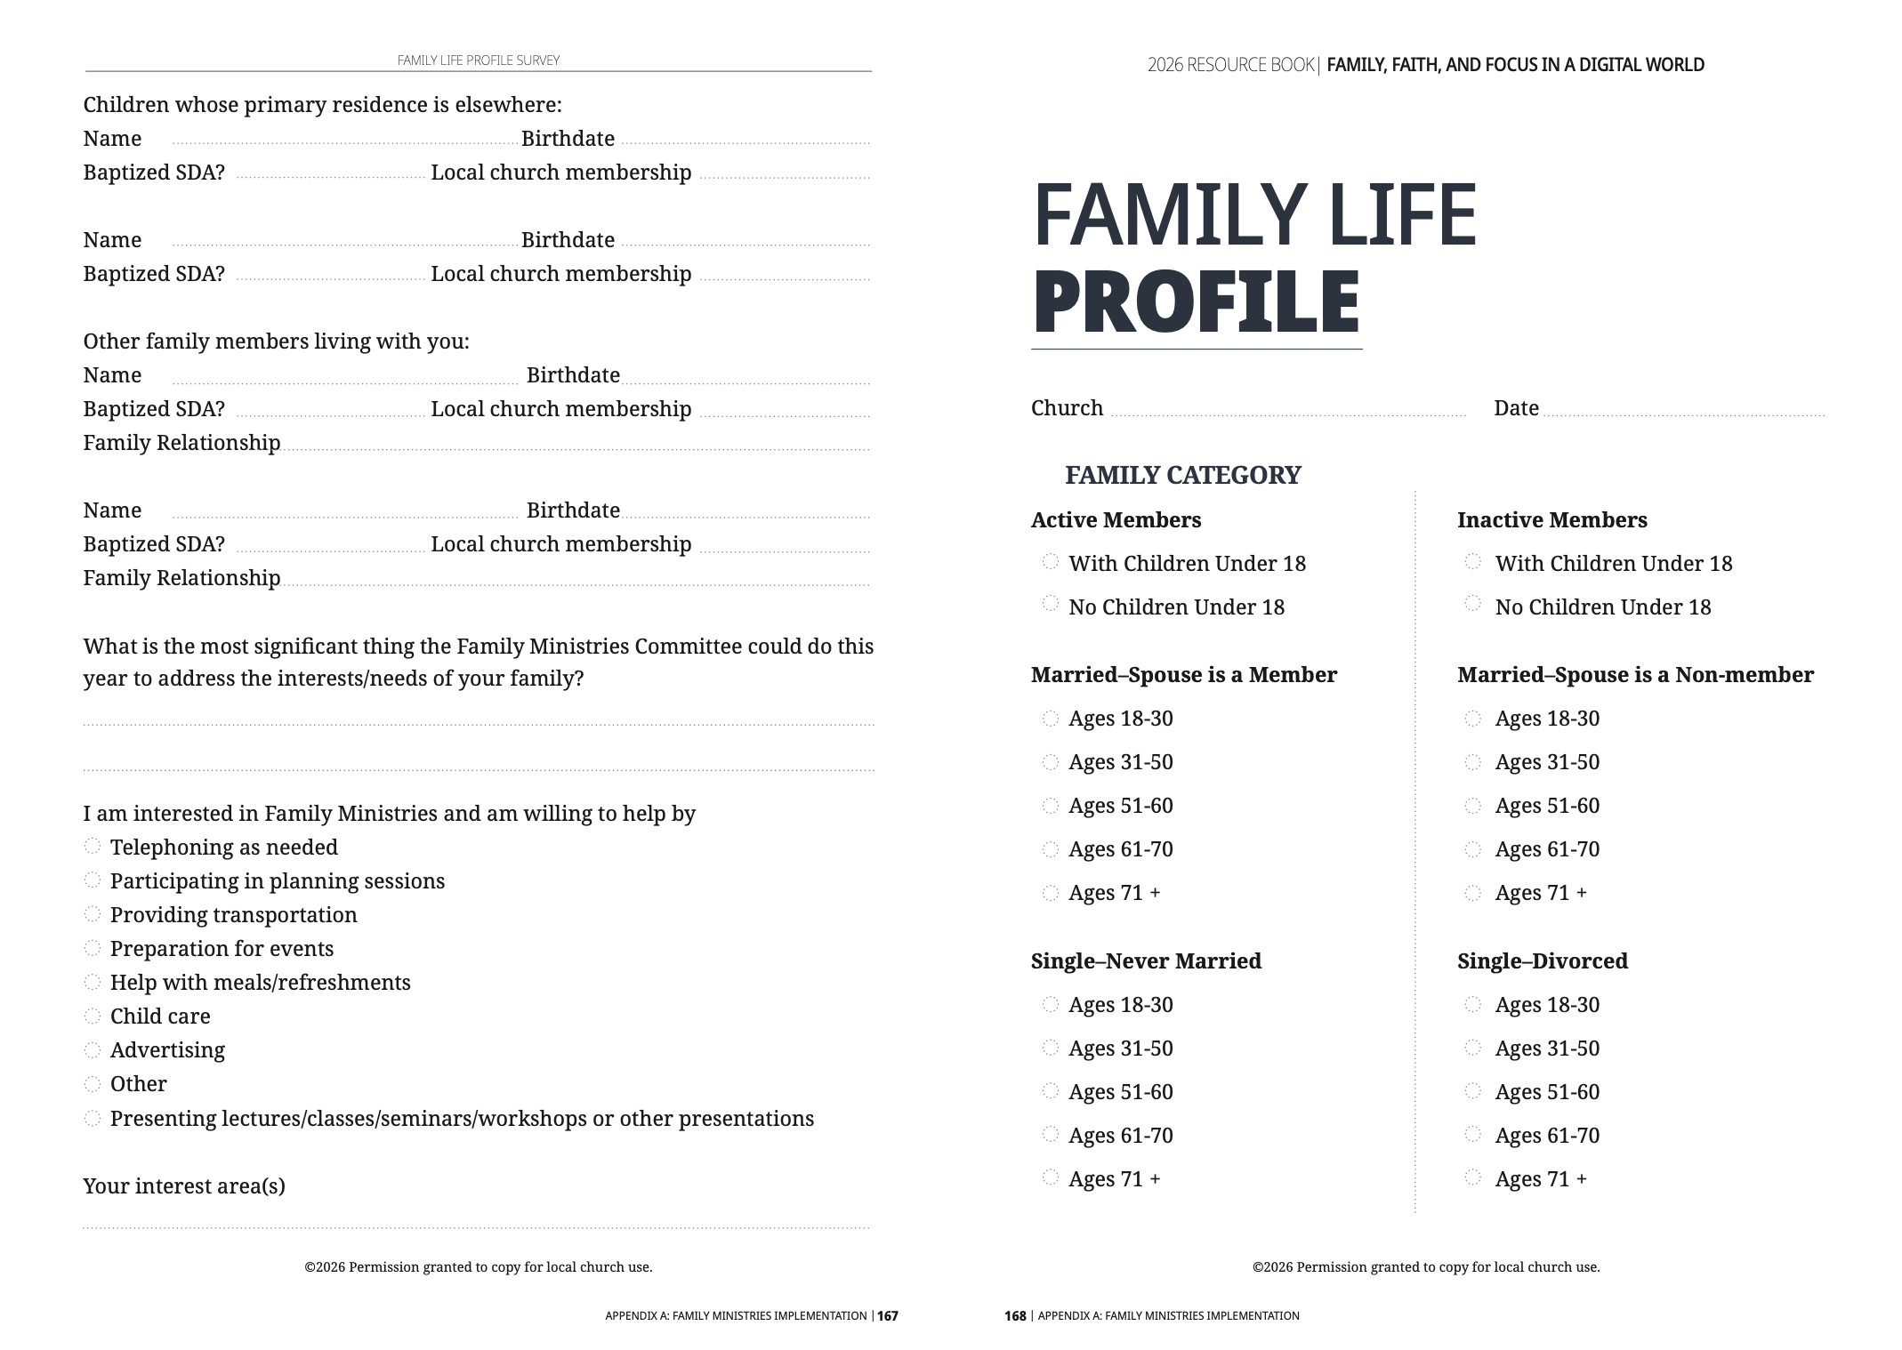

Slide 8
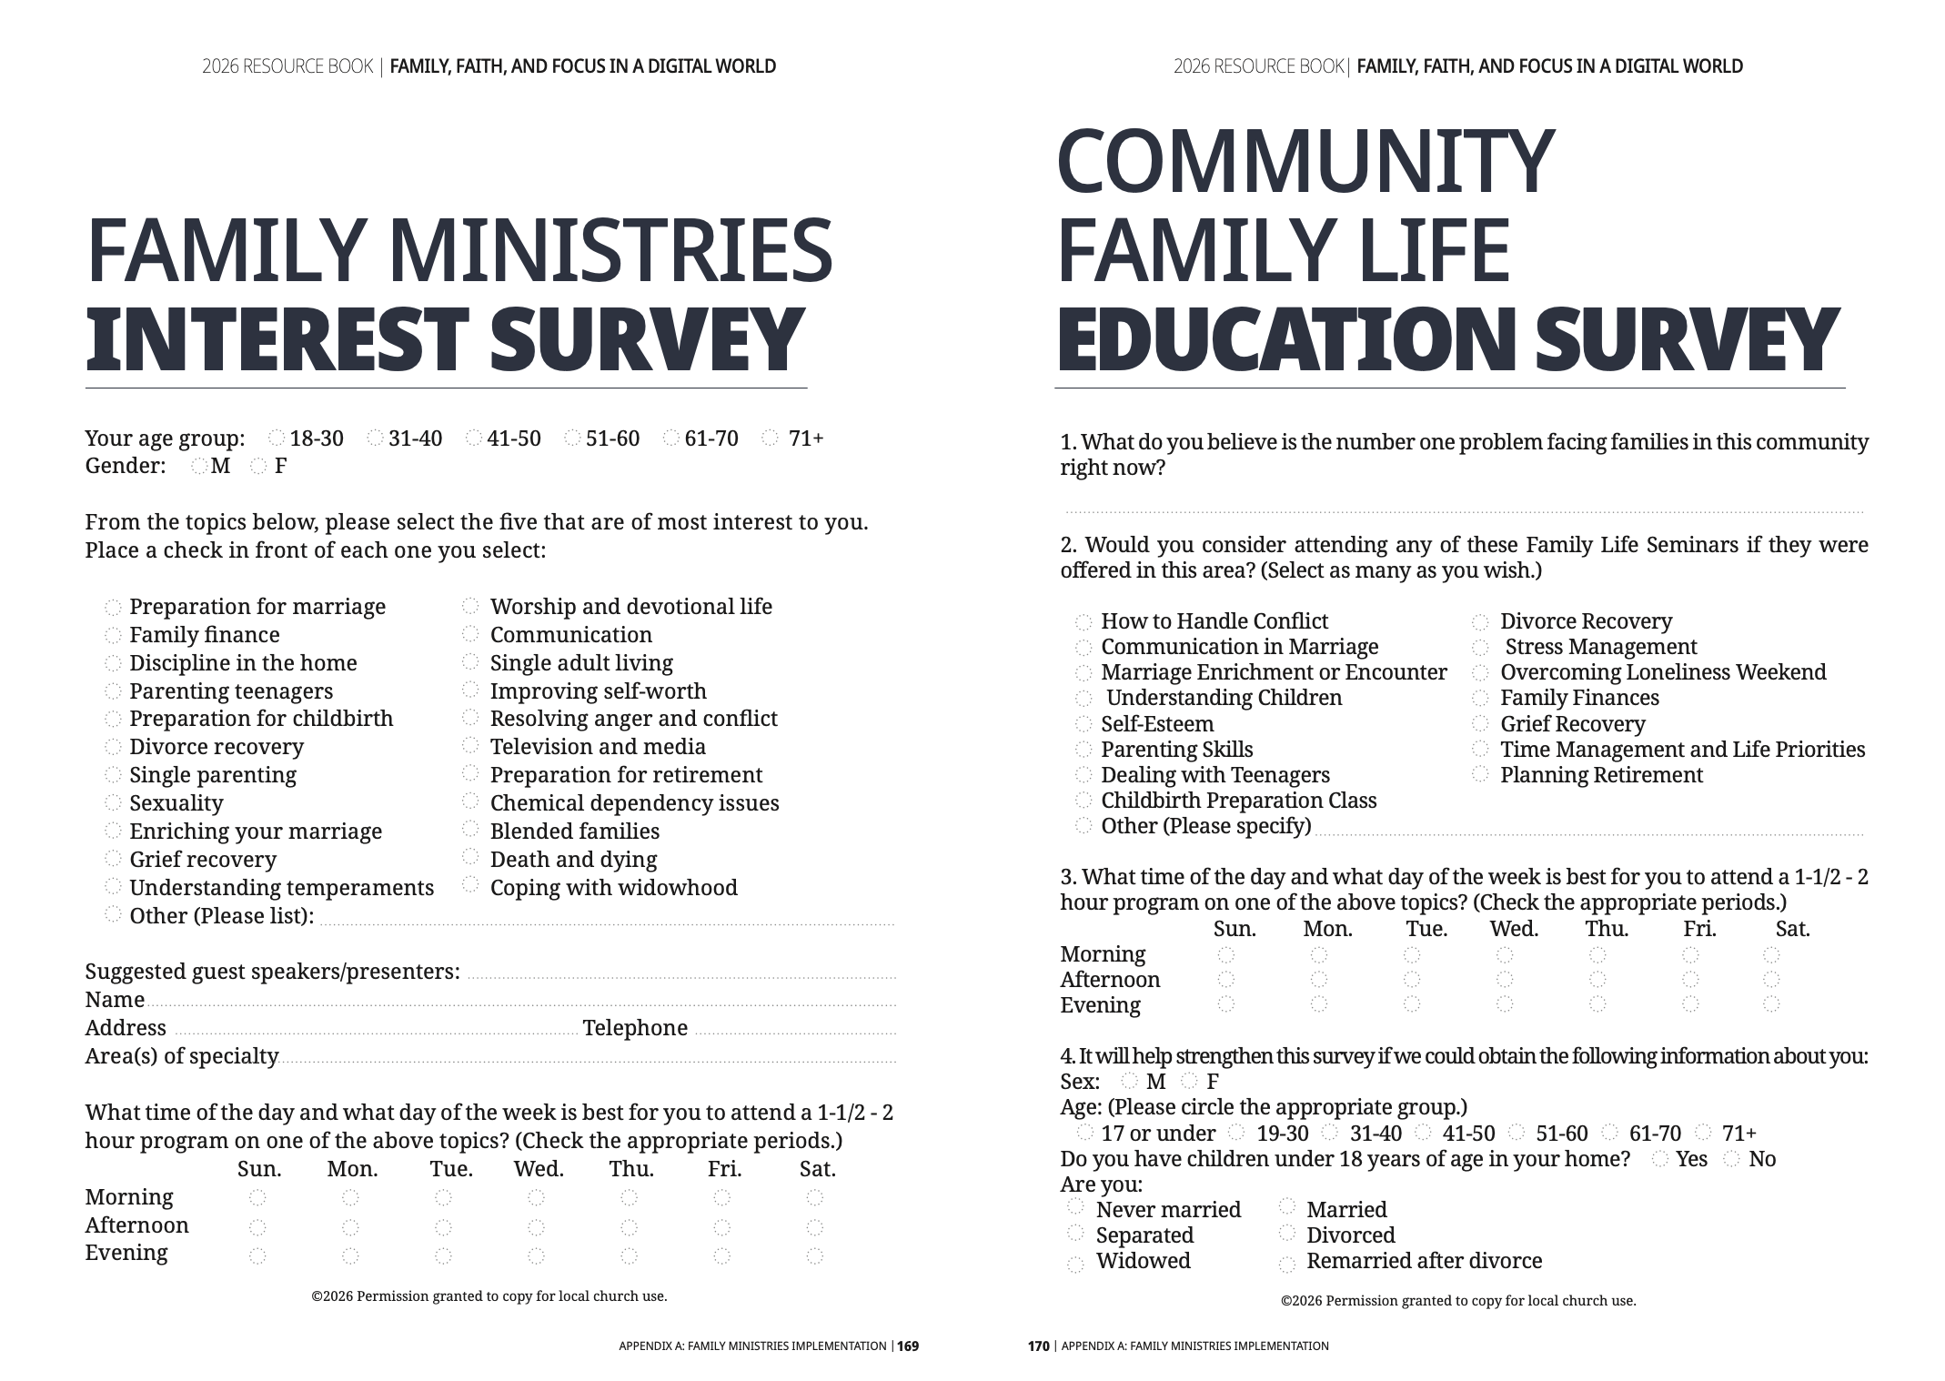

Slide 9
DATA NEEDED FOR GATHERING
Number of families per local church
Number of Single parents, Widows/Widowers, Senior Citizens
Number of Families who participated in the evangelism
Family Camp/Retreat (Number of families attended)
Family Leadership Certification (Number of Attendees)
Number of churches/ families participated in Christian Home and Marriage Week | Family Togetherness Week of Prayer
CLPM CHURCH OFFICERS’ ORIENTATION
Notes:
Family Ministries Leaders - DISTRICT OFFICERS
AREA OFFICERS – DISTRICT PRESIDENTS

Slide 10
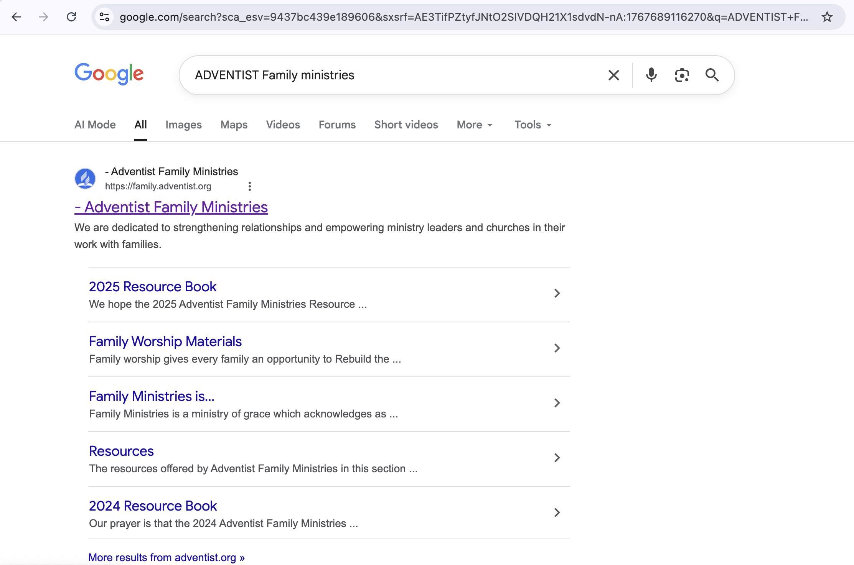
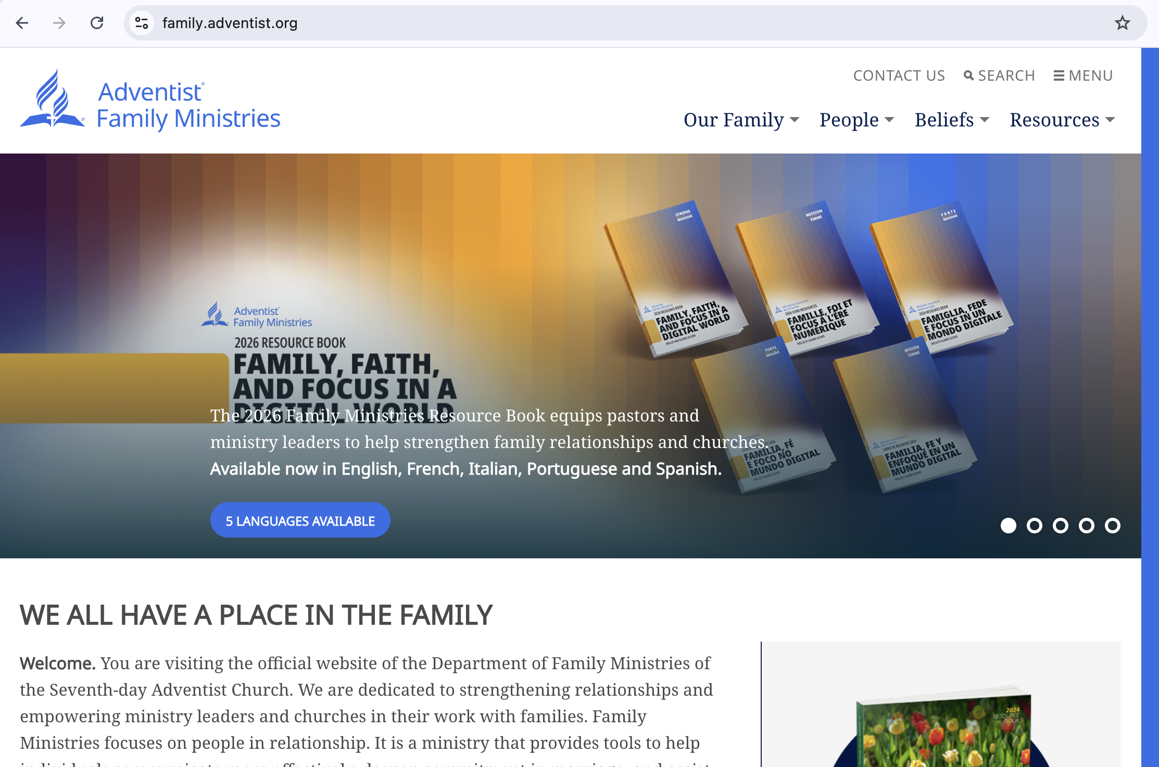
CLPM CHURCH OFFICERS’ ORIENTATION

Slide 11

Family Enrichment material ( Family Time )
CLPM CHURCH OFFICERS’ ORIENTATION
Notes:
EGW app

Slide 12
CLPM CHURCH OFFICERS’ ORIENTATION
Notes:
CHRISTIAN marriage day – emphasize in marriage – marriage sermon and marriage seminar
Christian Home Day – emphasize in parenting

Slide 13
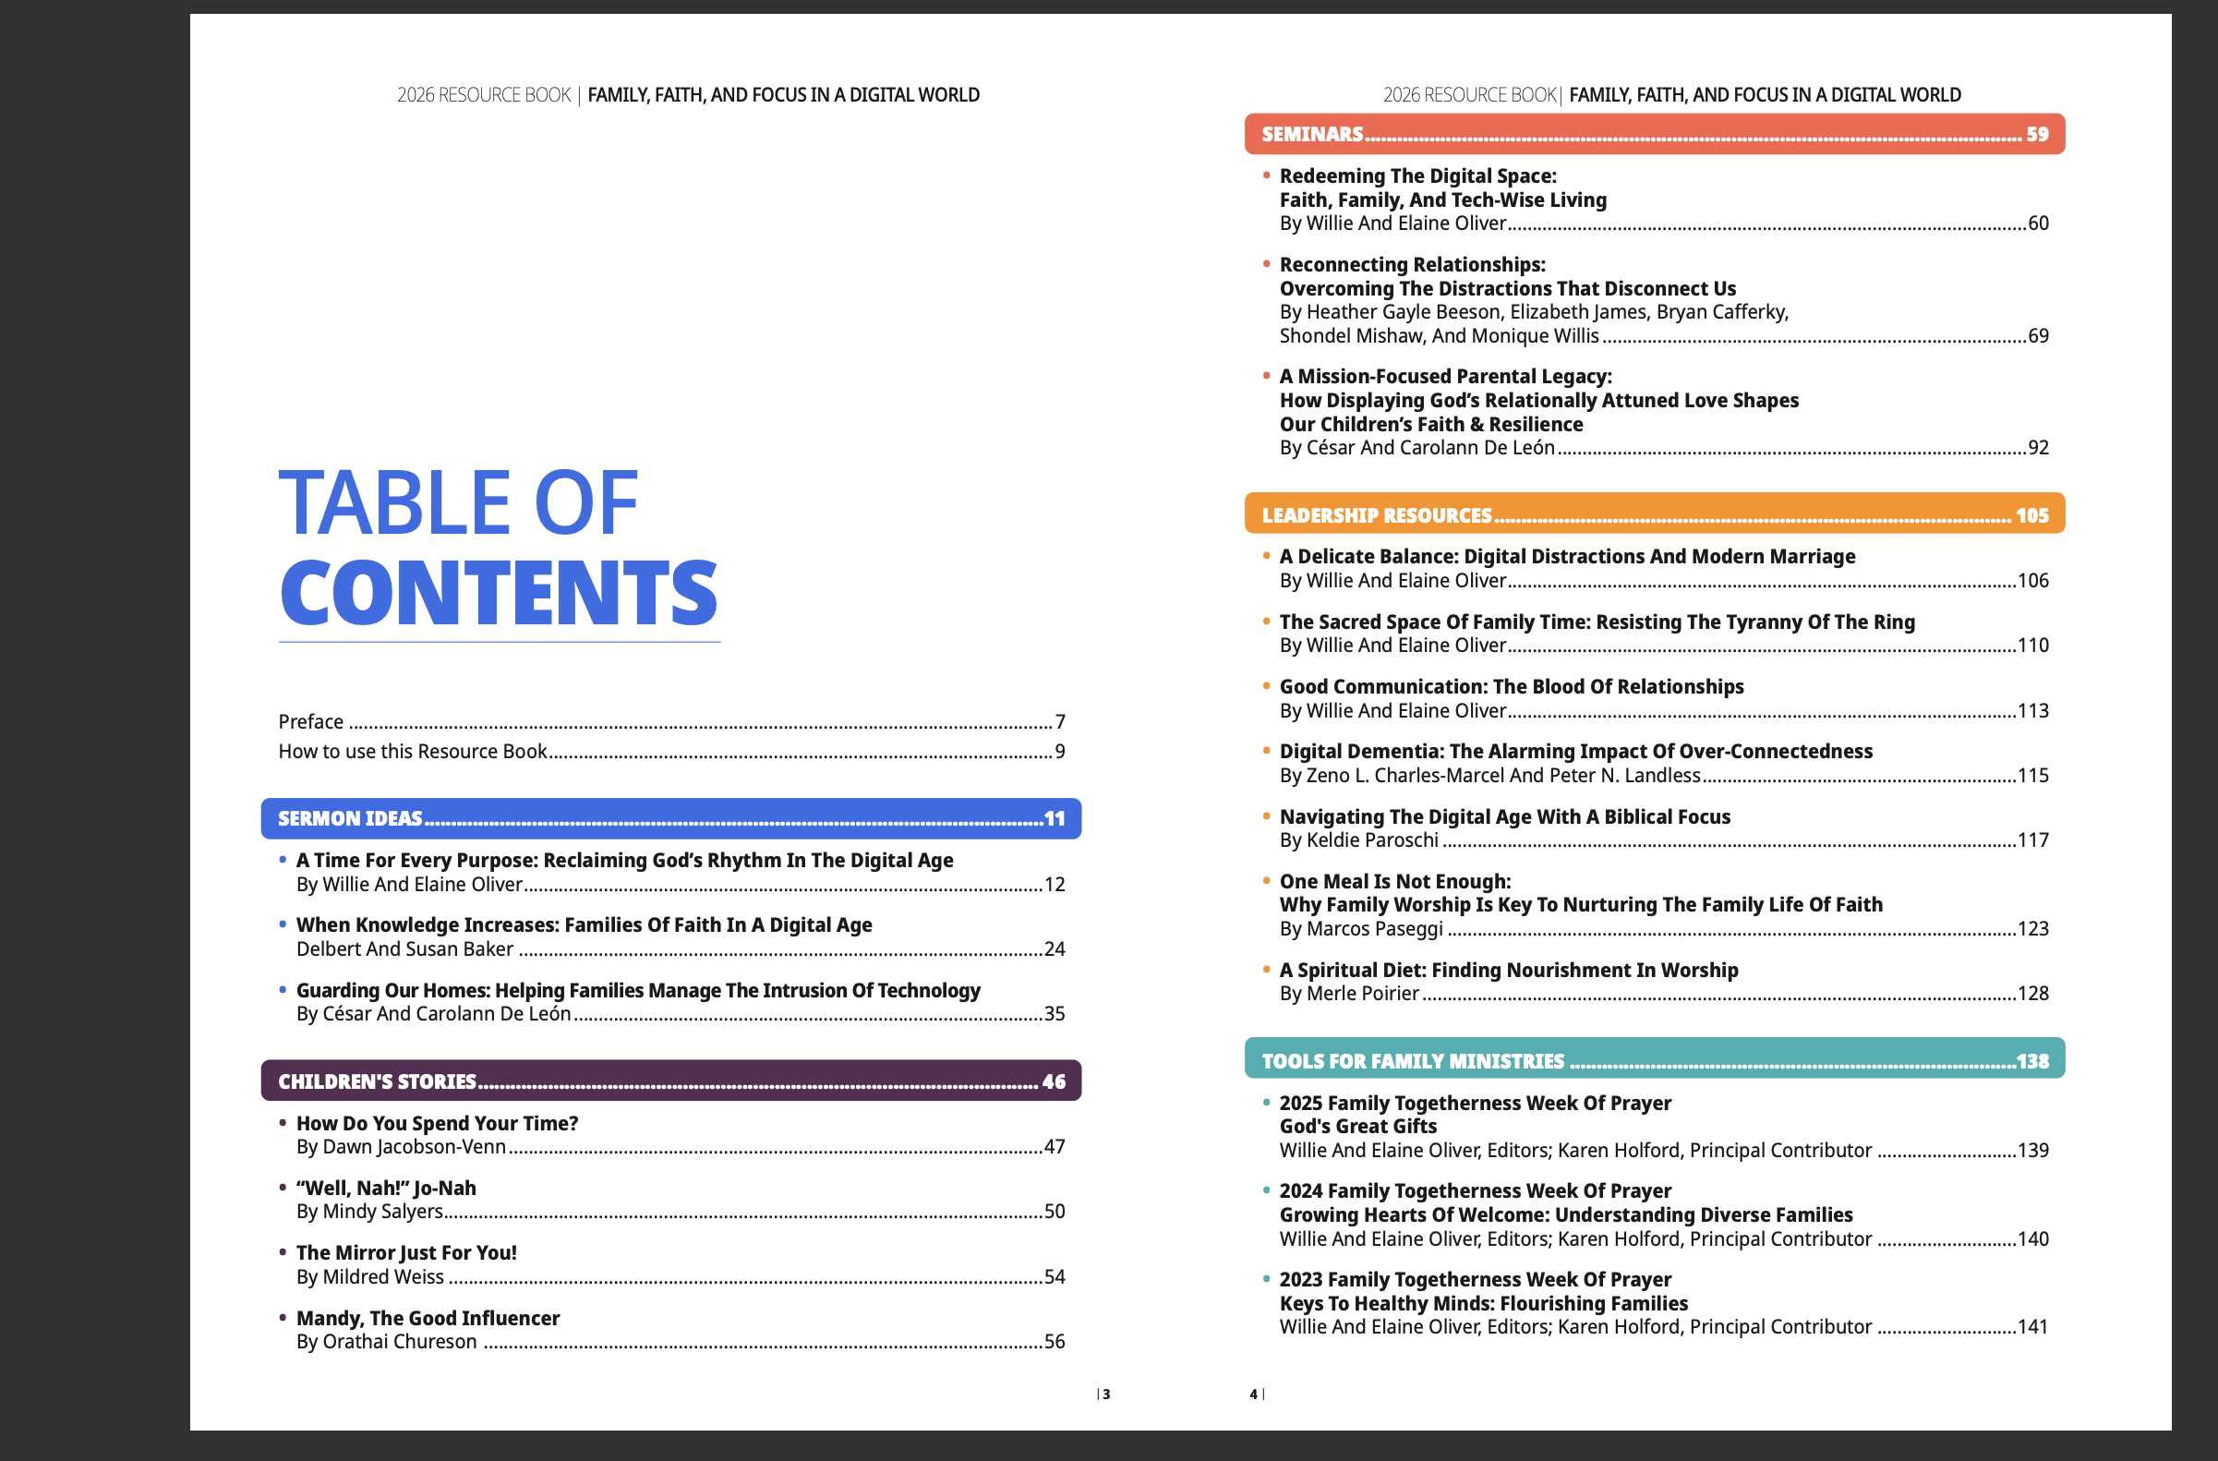
CLPM CHURCH OFFICERS’ ORIENTATION

Slide 14
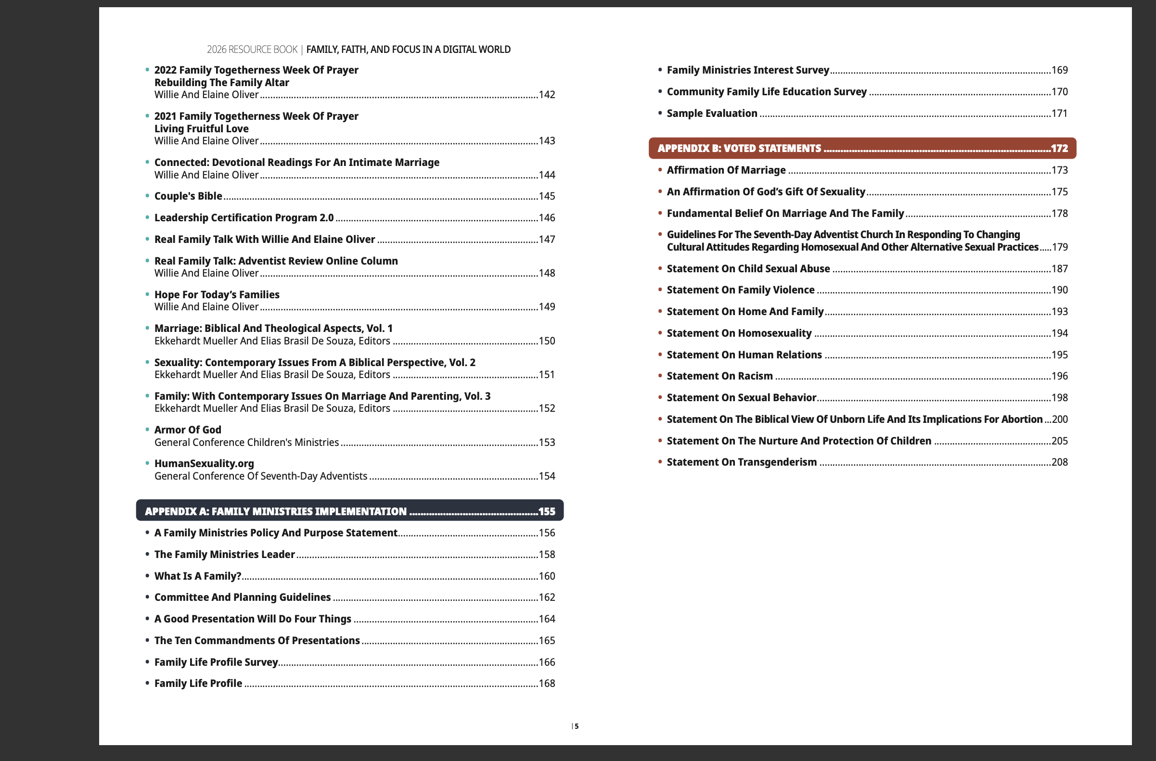
CLPM CHURCH OFFICERS’ ORIENTATION

