Slide 1




Central Luzon Provinces Mission
of the Seventh-day Adventists
CHURCH CLERKS
& ASSOCIATES’
ORIENTATION
JANUARY 18, 2026

Slide 2

BREAK-OUT SESSION OUTLINE
Duties of the Clerk
Church Profiling
ACMS
CLPM VIRTUAL CHURCH OFFICERS’ ORIENTATION

Slide 3

Much of the efficient functioning of the church depends on the work of
the clerk. Because of the important and specialized functions of this office, it is wise to choose one who can be elected to a new term of office to provide continuity in record keeping and reporting. Large churches may elect assistant clerks as needed. When the clerk, as secretary, cannot attend a business meeting, the clerk should arrange for an assistant to be present to take the minutes.
CHURCH MANUAL p.87
CLPM VIRTUAL CHURCH OFFICERS’ ORIENTATION

Slide 4
DUTIES OF THE CHURCH CLERK
Secretary church board and business meetings - Although a church secretary sometimes is delegated this responsibility, it is the duty of the clerk to see that this task is performed and properly entered in the church records. The official copy of the minutes should include complete copies of all reports, documents and financial statements. It is a public record which any church member or denominational representative can look at.
CLPM VIRTUAL CHURCH OFFICERS’ ORIENTATION

Slide 5
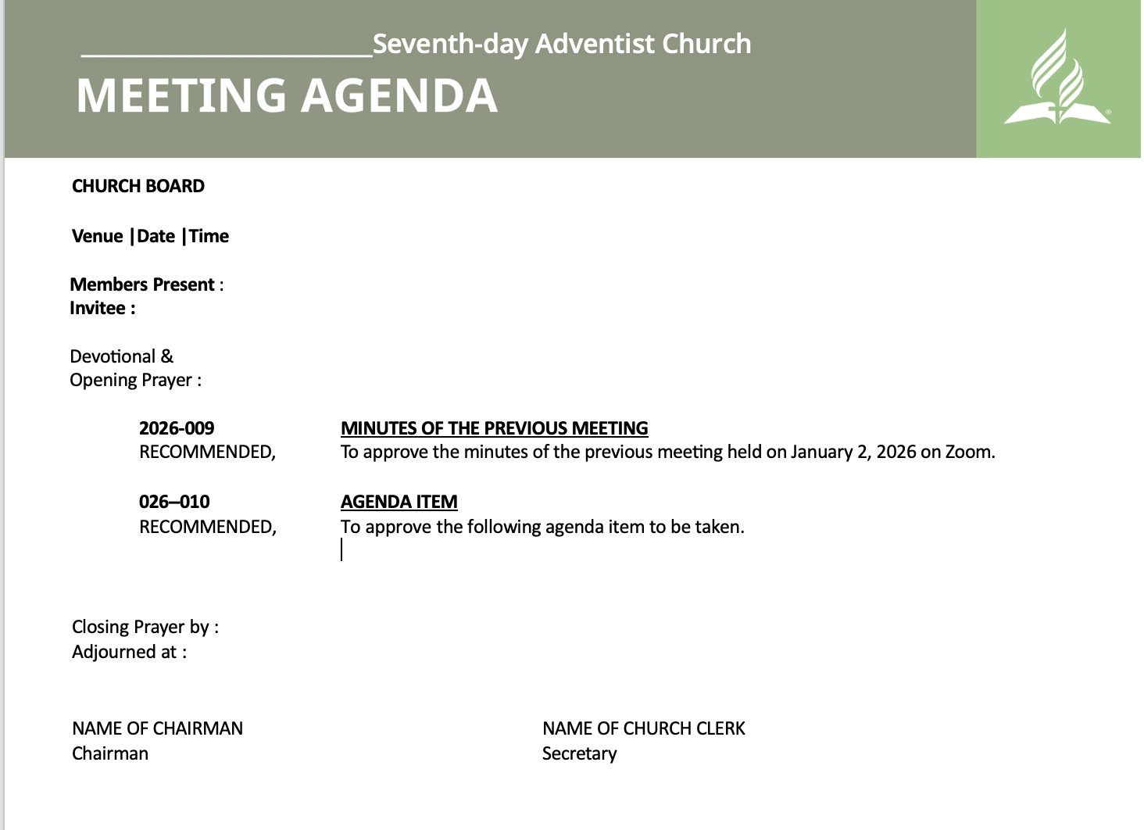

Slide 6
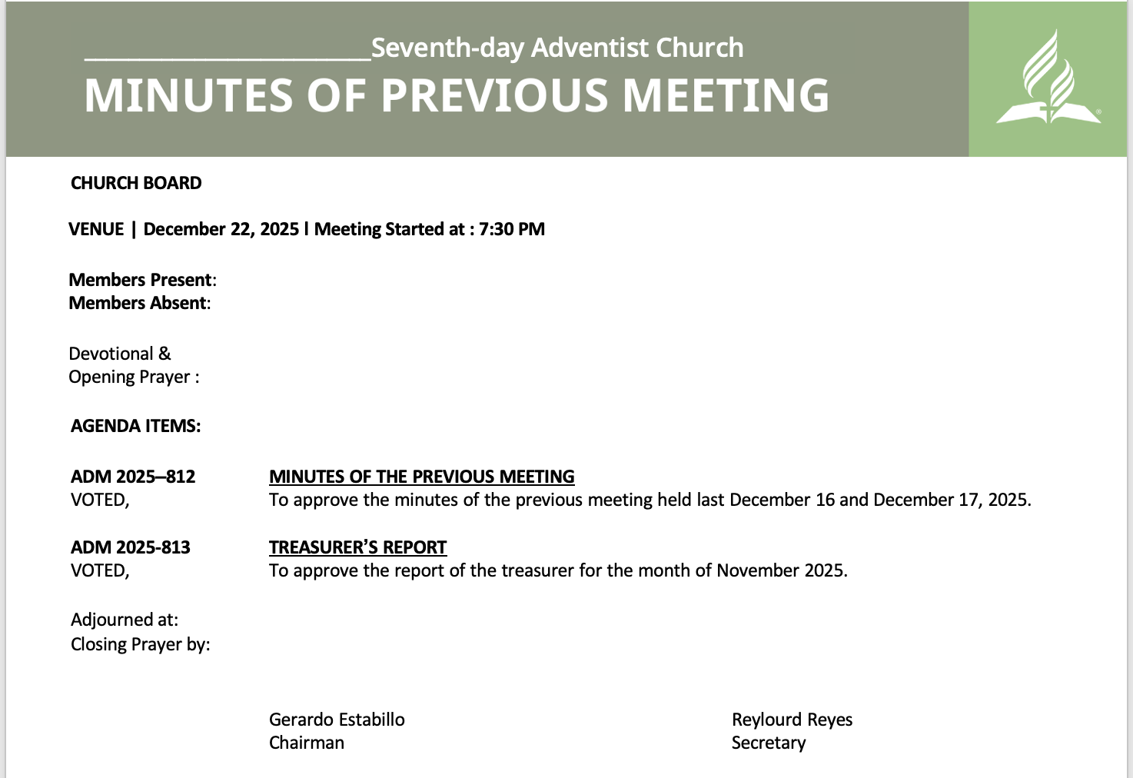

Slide 7
DUTIES OF THE CHURCH CLERK
Church membership - There must always be a vote by the church, not just the church board, to add or drop a name from the church membership roll, except in the case of the death of a member. The clerk handles the correspondence between the individuals seeking transfers and the churches with which the transfer is being made. The clerk also fills out a certificate and report forms when a person is baptized or makes a profession of faith.
CLPM VIRTUAL CHURCH OFFICERS’ ORIENTATION

Slide 8
DUTIES OF THE CHURCH CLERK
In cooperation with the Sabbath School teachers, you should take a keen interest in keeping track of each member, making note of those who do not attend regularly and those who are absent. When a member moves away, the church clerk should try to keep in touch with them and promptly contact the pastor in the new district to have him visit them and encourage them to transfer to a new church home.
CLPM VIRTUAL CHURCH OFFICERS’ ORIENTATION

Slide 9
DUTIES OF THE CHURCH CLERK
Church records - All church records, minutes of business meetings and board meetings, the church officer list, and the list of church members are maintained by the church clerk. This information is not only for the sake of the church family but portions of this information are also sent on special forms to the local conference office for its use in statistical reports. Also, it is vital that you supply copies of these records to new pastors and church board members so they have the information needed for their work.
CLPM VIRTUAL CHURCH OFFICERS’ ORIENTATION

Slide 10
DUTIES OF THE CHURCH CLERK
List of committees - The clerk should make note of any committees that are appointed and give the chairman of the group a list of the members making up the committee, along with an outline of the work the committee is being asked to accomplish.
CLPM VIRTUAL CHURCH OFFICERS’ ORIENTATION

Slide 11
OTHER CONCERNS
Commitment - One to two hours per week.
Church history – Important milestones to be recorded
CLPM VIRTUAL CHURCH OFFICERS’ ORIENTATION

Slide 12
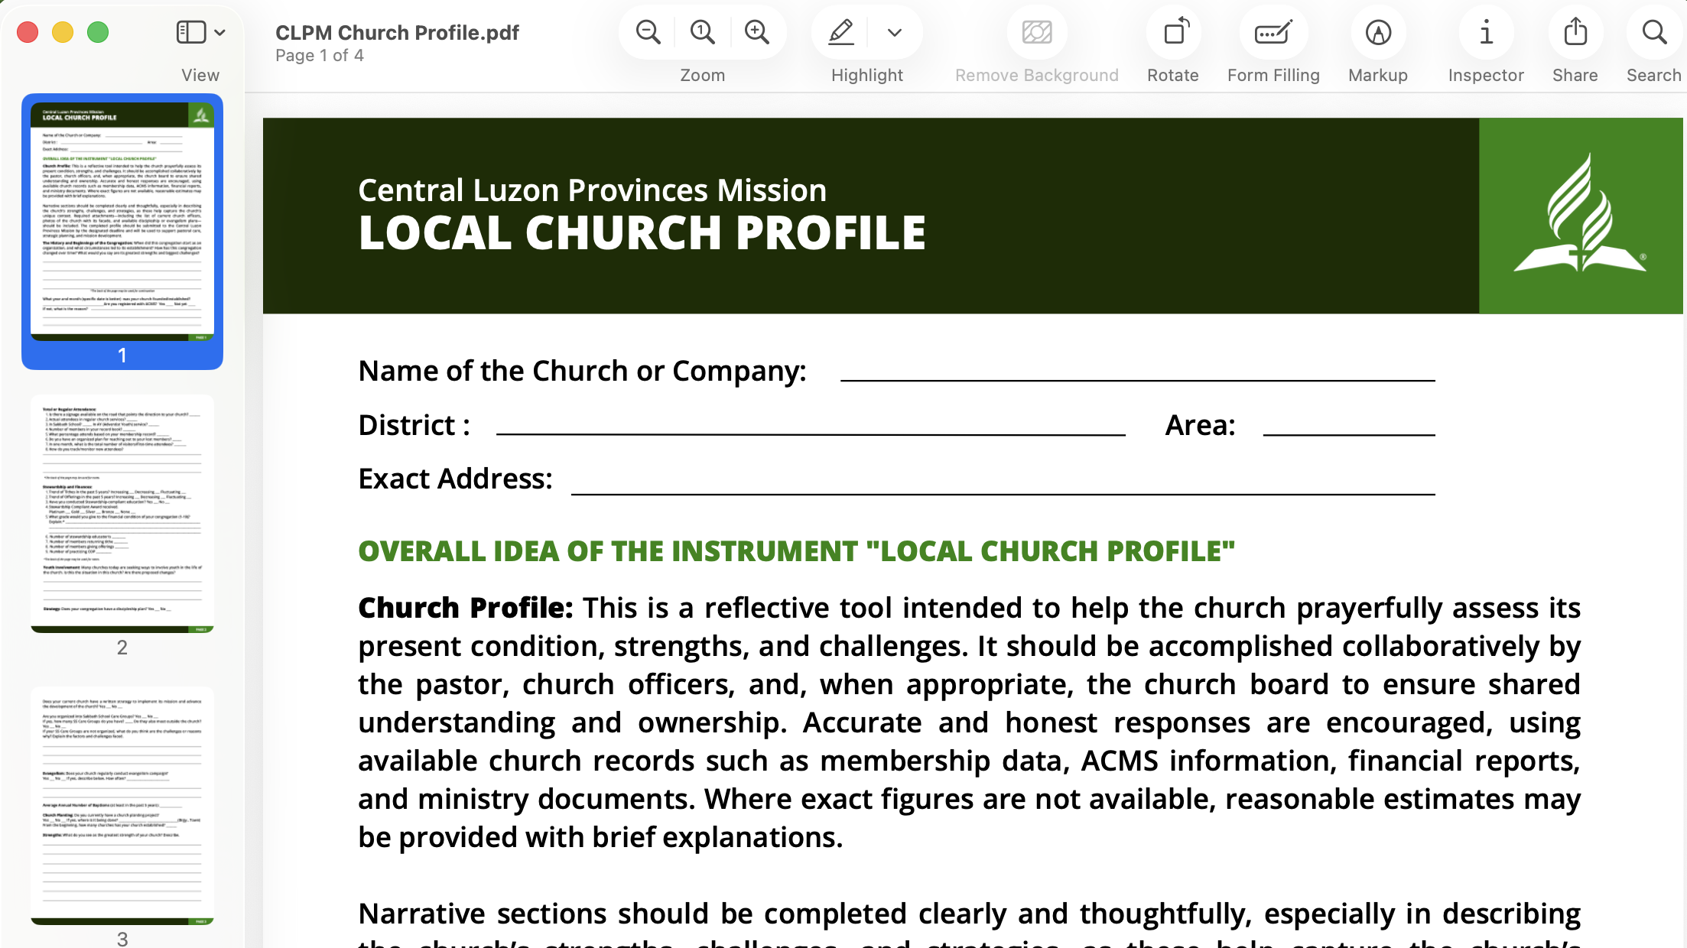

Slide 13
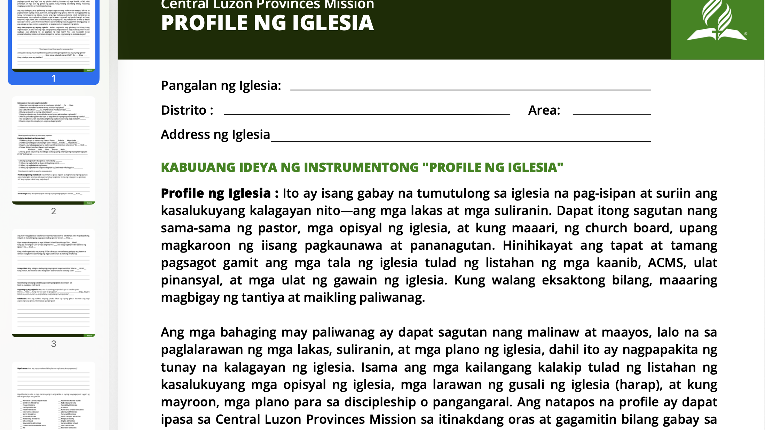

Slide 14
ADVENTIST CHURCH MANAGEMENT SYSTEM
https://clpm.adventist.ph/resources/acms-how/
CLPM VIRTUAL CHURCH OFFICERS’ ORIENTATION

Slide 15
