Slide 1

VIDEOGRAPHY
FOR NEWS REPORT
PHILIP DOMINIC CARPENTERO,
CLPM COMMUNICATION PERSONNEL

Slide 2

Pursue the well-being of the city I have deported you to. Pray to the Lord on its behalf, for when it thrives, you will thrive.”
JEREMIAH 29:7
CSB

Slide 3
...let your light shine before others, so that they may see your good (beautiful) works...
MATTHEW 5:16
CSB

Slide 5
01
CREDIBILITY
Truth is the foundation.
  Show events as they really are
  Avoid manipulation or staging
  Maintain journalistic integrity

Slide 6
02
CONTEXT
Always establish the scene before going into details.
Your visuals should answer:
  What is happening?
  Where is it happening?
  Who is involved?

Slide 7
03
CLARITY
Your audience must easily understand the story.
  Keep shots simple and focused
  Avoid visual clutter
  Make sure the subject is obvious

Slide 8
04
CONSISTENCY
Maintain a uniform style throughout.
  Similar lighting and color tone
  Consistent audio levels
  Cohesive visual flow

Slide 9
05
CONTINUITY
Ensure smooth visual storytelling.
  Follow logical shot sequence
  Maintain screen direction (180-degree rule)
  Use B-roll to bridge cuts

Slide 10
06
COMPASSION
Respect the people in your story.
  Be sensitive in emotional situations
  Protect dignity and privacy
  Avoid exploitation

Slide 11
07
COMPOSITION
Frame your shots properly.
  Apply rule of thirds
  Maintain proper headroom and lead room
  Keep visuals balanced and intentional

Slide 12
07
COMPOSITION
  Light Exposure
  Rule of Thirds (Framing)
  Camera Angles and Movements
  Color Temperature

Slide 13
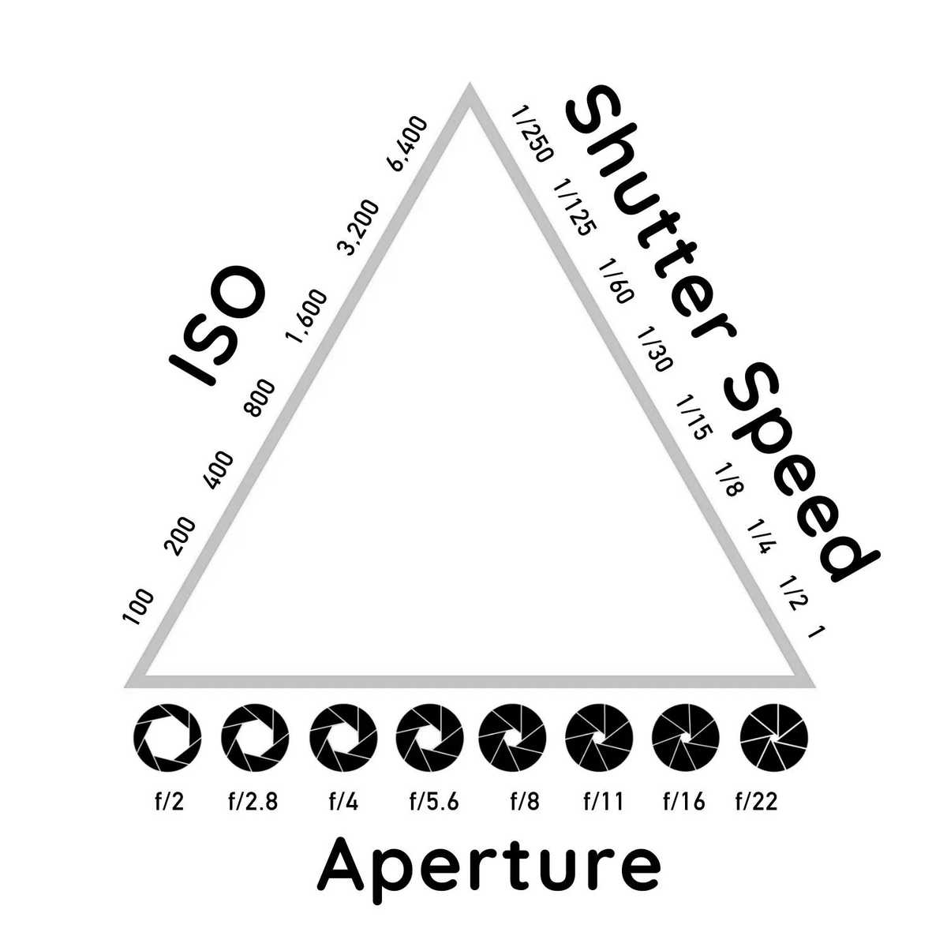
EXPOSURE TRIANGLE

Slide 14
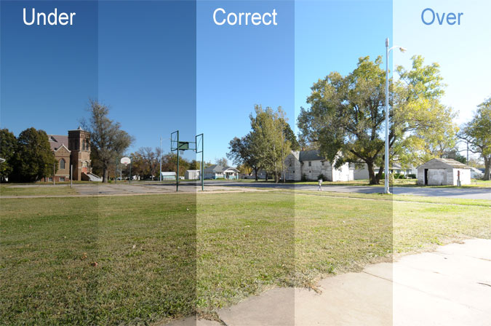
EXPOSURE TRIANGLE

Slide 15
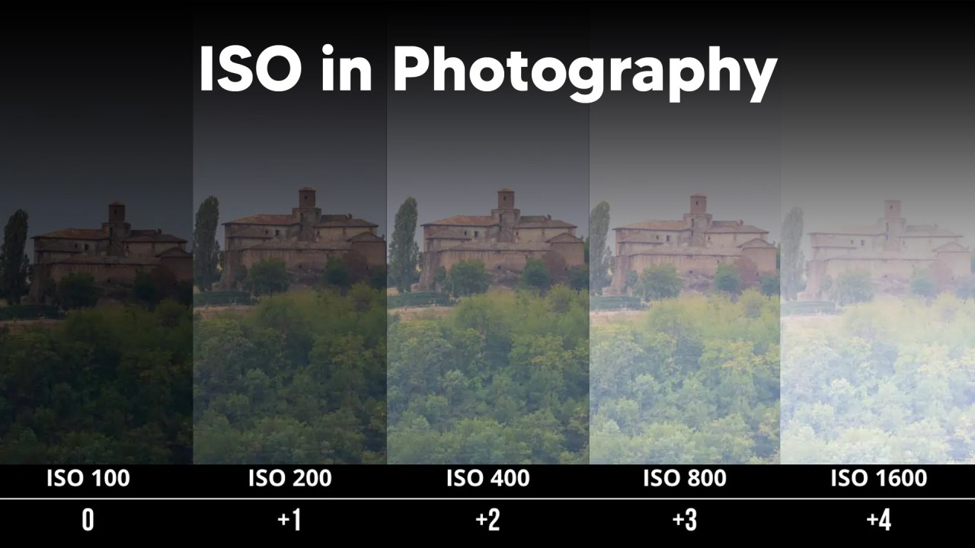
EXPOSURE TRIANGLE

Slide 16
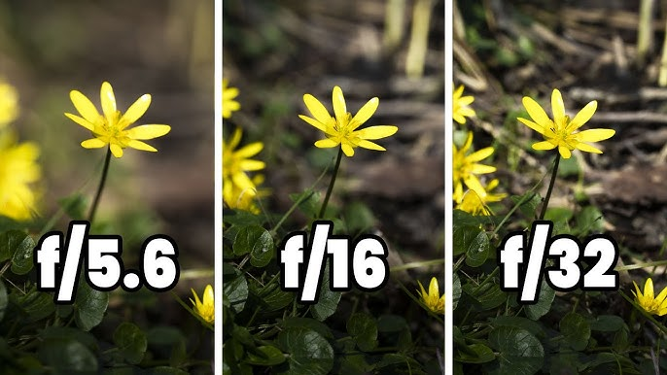
EXPOSURE TRIANGLE

Slide 17
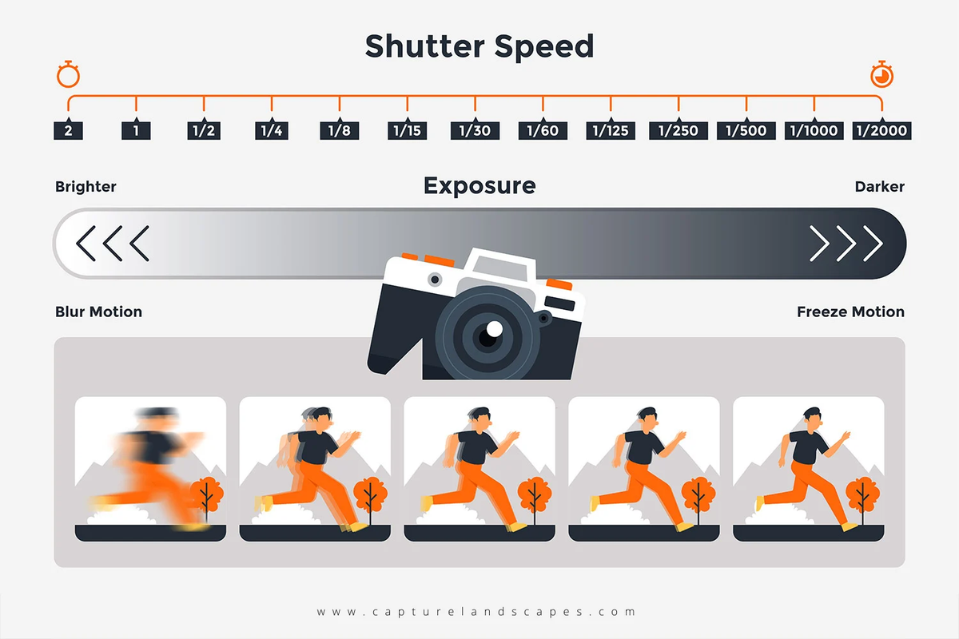
EXPOSURE TRIANGLE

Slide 18
PHONE SETUP
  Set to 1080p resolution
  Set to 24 fps or 30 fps
  Lock the Exposure and Focus especially in still shots like interviews and reporters
  For color consistency use same temperature.

Slide 19
07
COMPOSITION
  Light Exposure
  Rule of Thirds (Framing)
  Camera Angles and Movements
  Color Temperature

Slide 20
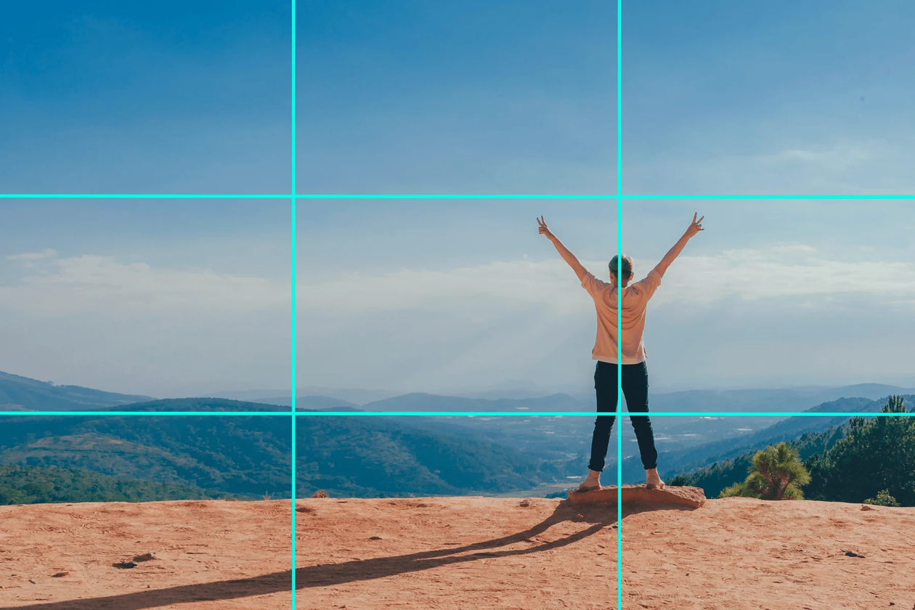
RULE OF THIRDS

Slide 21
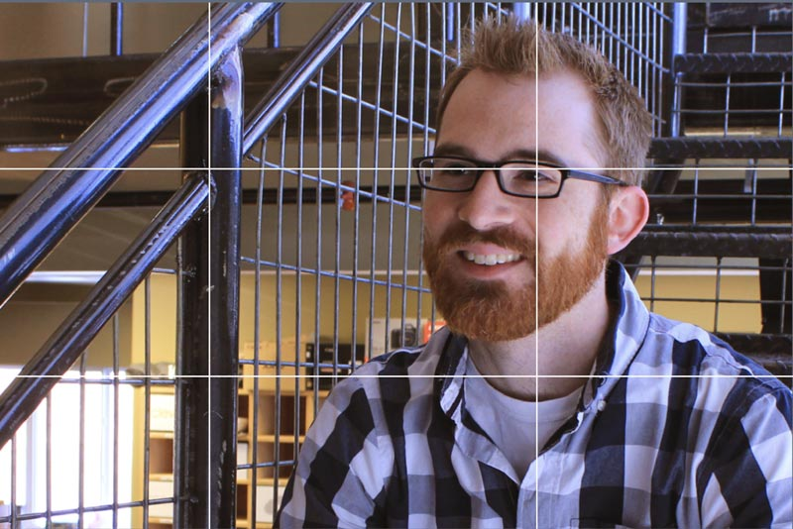
RULE OF THIRDS

Slide 22
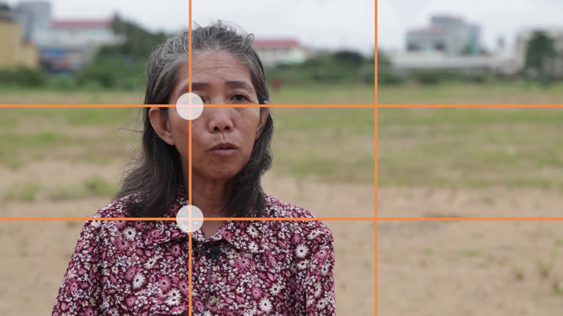
RULE OF THIRDS

Slide 23
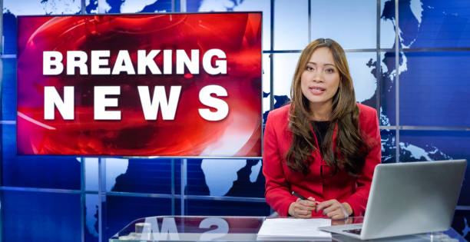
RULE OF THIRDS

Slide 24
07
COMPOSITION
  Light Exposure
  Rule of Thirds (Framing)
  Camera Angles and Movements
  Color Temperature

Slide 25
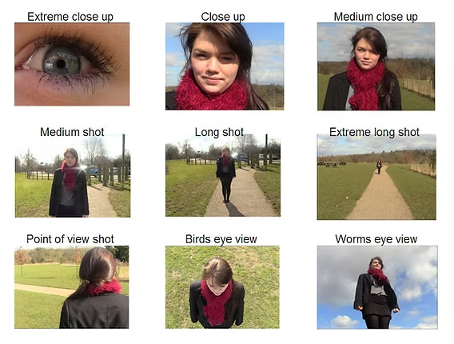
CAMERA ANGLES

Slide 26
07
COMPOSITION
  Light Exposure
  Rule of Thirds (Framing)
  Camera Angles and Movements
  Color Temperature

Slide 27
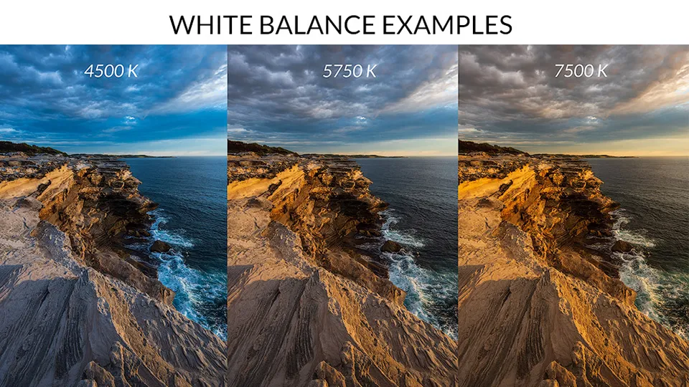
COLOR TEMPERATURE

Slide 28
07
COMPOSITION
  Light Exposure
  Rule of Thirds (Framing)
  Camera Angles and Movements
  Color Temperature

Slide 29
VIDEOGRAPHY
FOR NEWS REPORT
PHILIP DOMINIC CARPENTERO,
CLPM COMMUNICATION PERSONNEL

